Slide 1
CS-E4870 Multi-Armed Bandit Based Automation of a Marketing Problem
Muhammad Abdullah Khan
Supervisor: Neda Barzegar Marvasti

Slide 2
Contents
What is Multi-Armed Bandit (MAB) Problem?
How to address this problem?
Website Optimization Example
Solutions
Experimental Setup
Results & Analysis

Slide 3
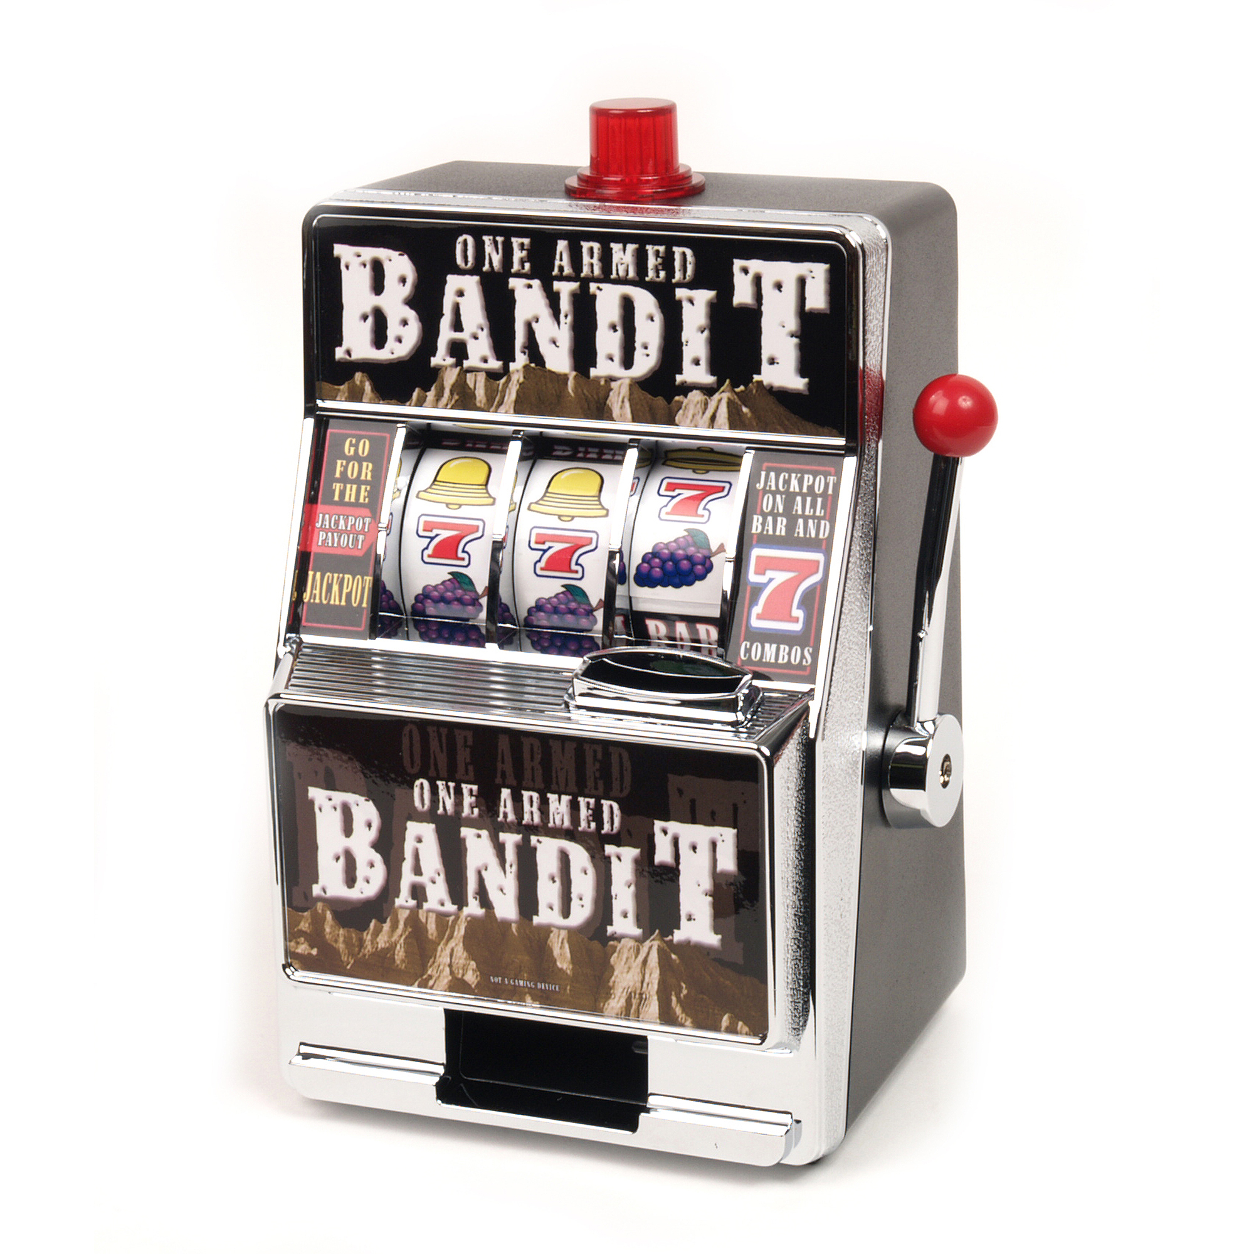
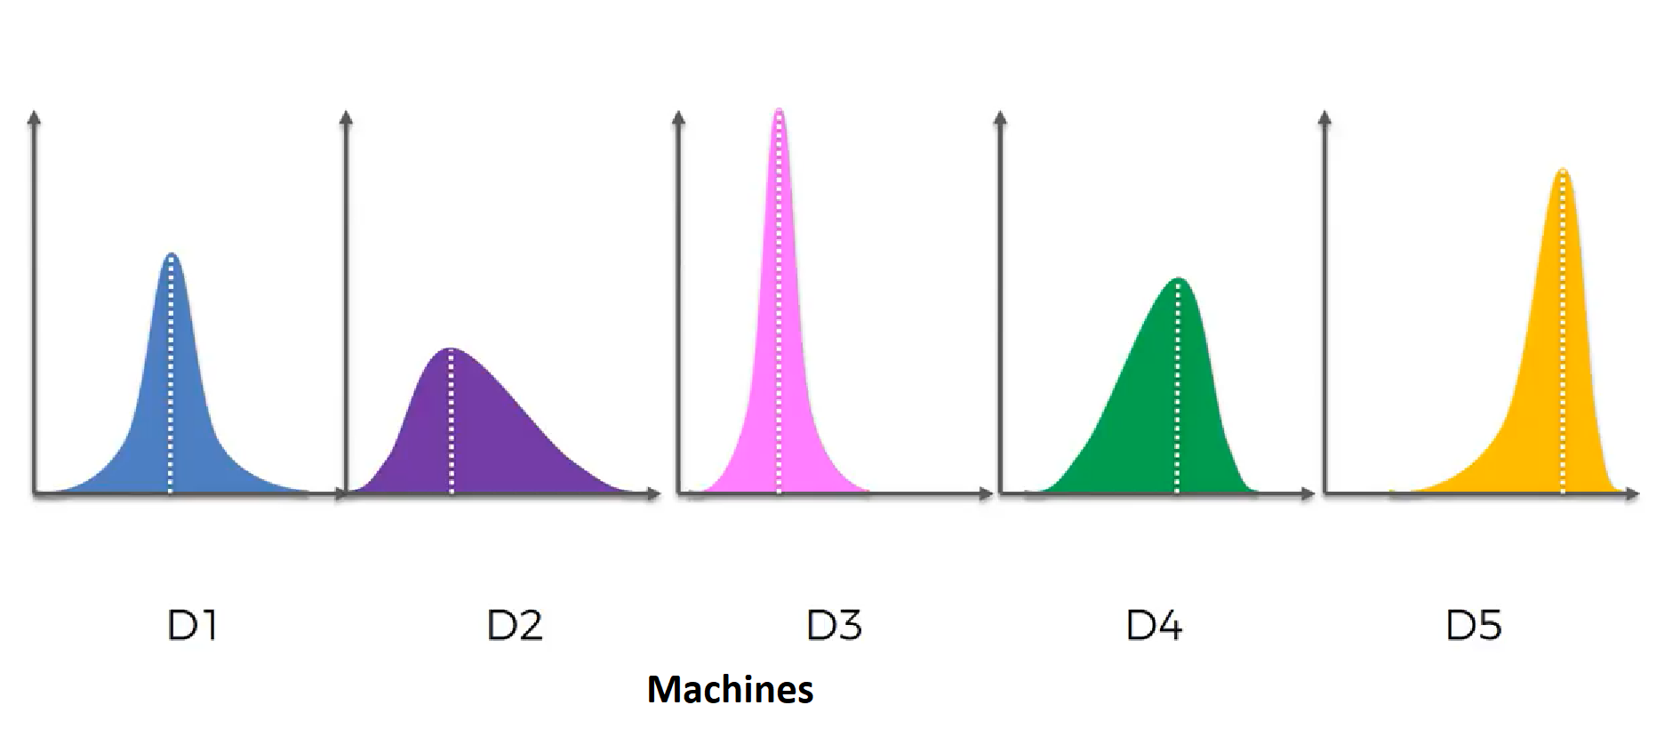
What is MAB Problem?
The MAB problem is derived from slot machines in casinos.
The goal is to pick from multiple machines to get the most favorable outcome.
The probabilities are unknown to the agent (human) and must be inferred via multiple trials.
Source: https://www.walmart.com/ip/One-Armed-Bandit-Slot-Bank/40811129
Source: https://www.youtube.com/watch?v=UlgmUEKr7Lw

Slide 4
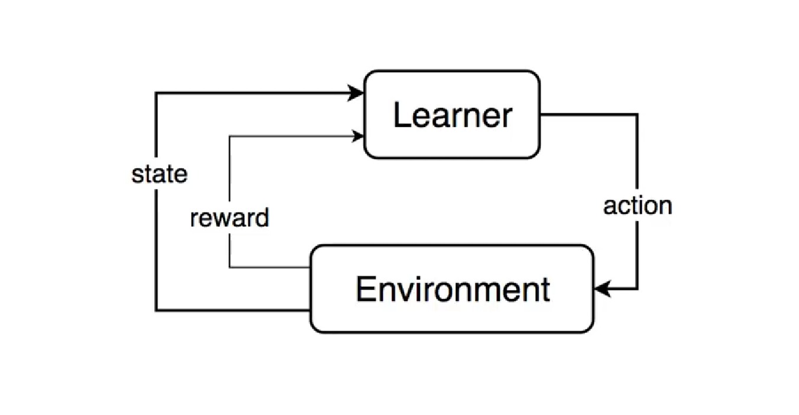
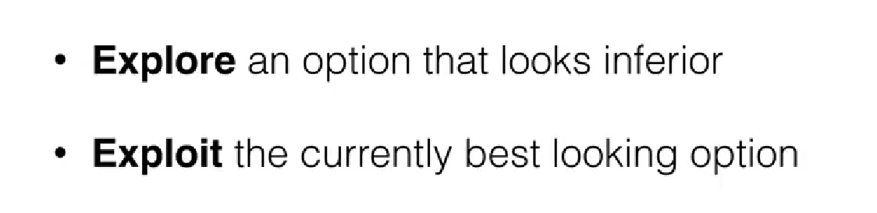
How to address this problem?
MAB problem is an example of classical reinforcement learning.
The objective is to explore multiple actions and exploit the one with the most favorable outcome.
But, limitations is the number of actions required.
Source: https://www.youtube.com/watch?v=qAvY2tkMHHA

Slide 5
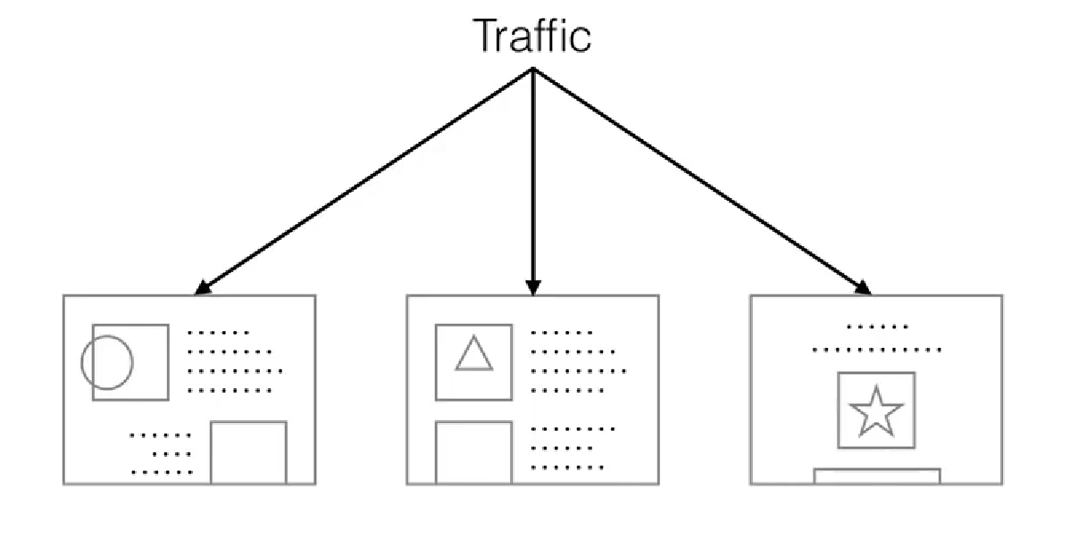
Website Optimization Example
In Pay per click (PPC) websites, the goal is to shortlist advertisements which generate the most leads (user clicks).
A naïve approach is A/B testing, equivalent to only exploring but not exploiting.
The approach wastes time and money in
Source: https://www.youtube.com/watch?v=qAvY2tkMHHA

Slide 6
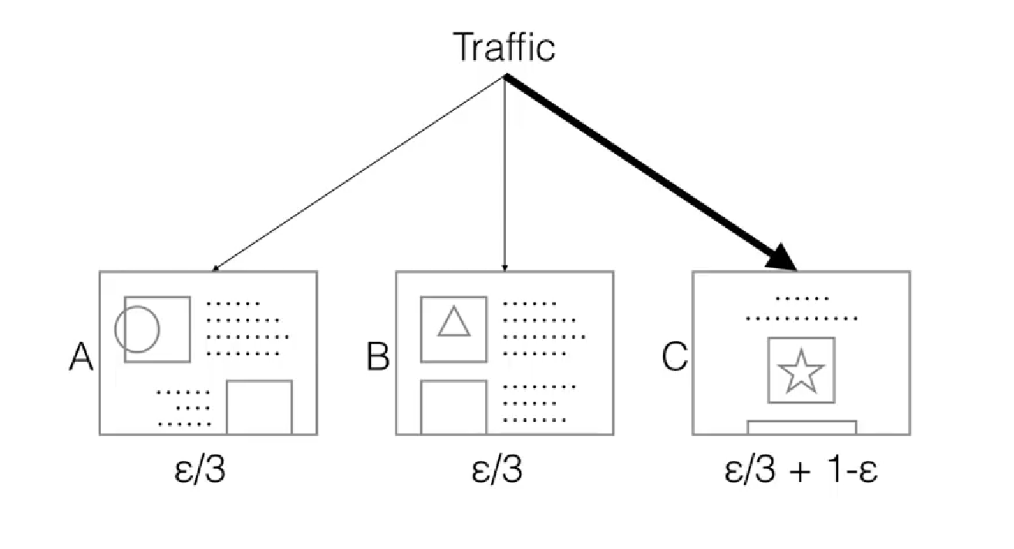
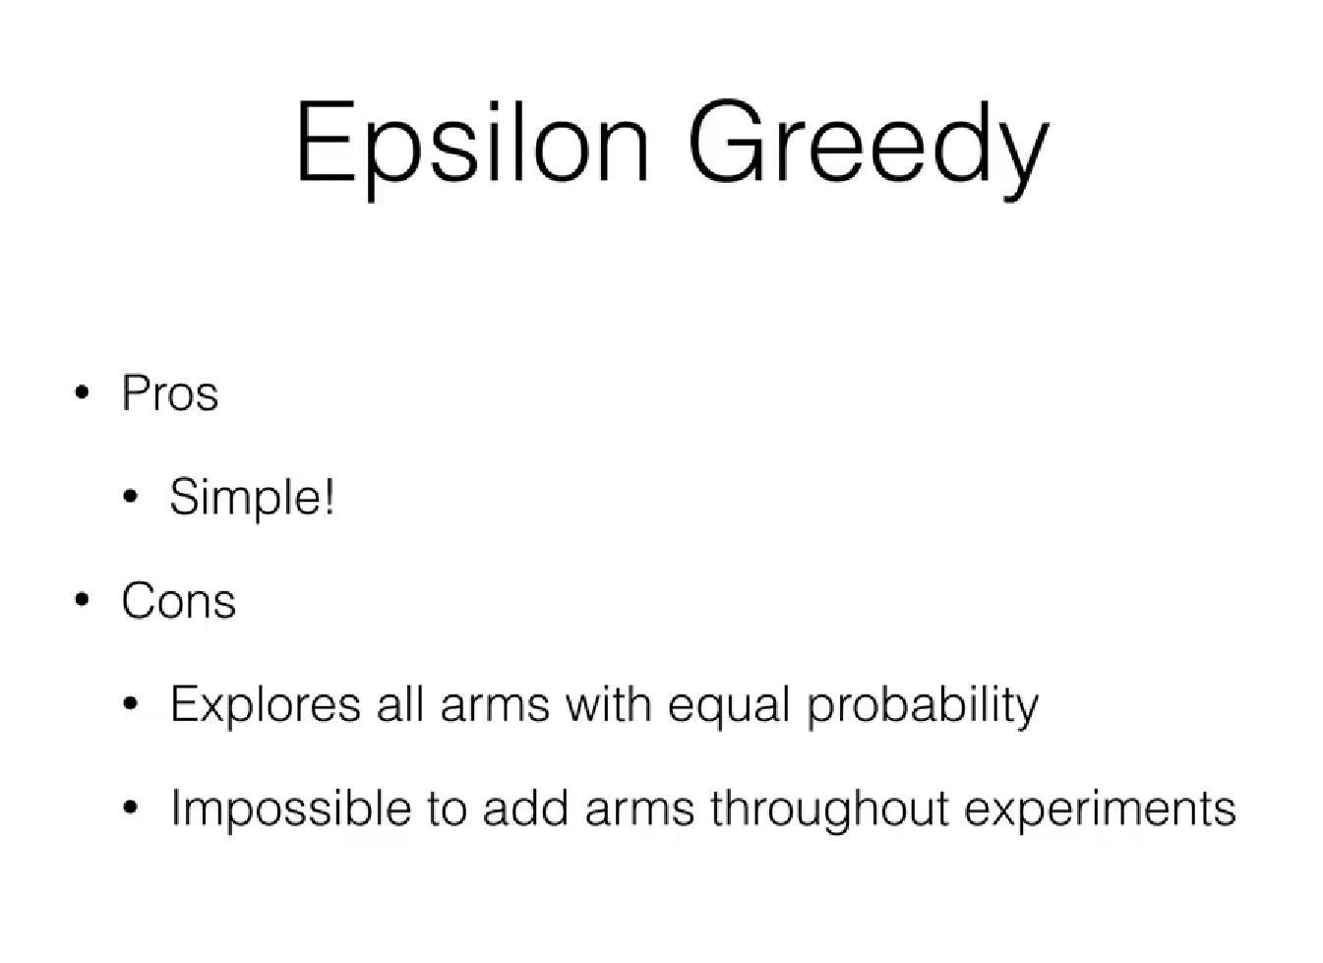
Solutions
Epsilon-Greedy Algorithm
In this approach probabilities would be set up for each website (“bandit”) denoted by ‘ε’.
ε ~ 1 = exploration
ε ~ 0 = exploitation (greed)
A good starting value for ε is usually 10% or 0.1.
Source: https://www.youtube.com/watch?v=qAvY2tkMHHA

Slide 7
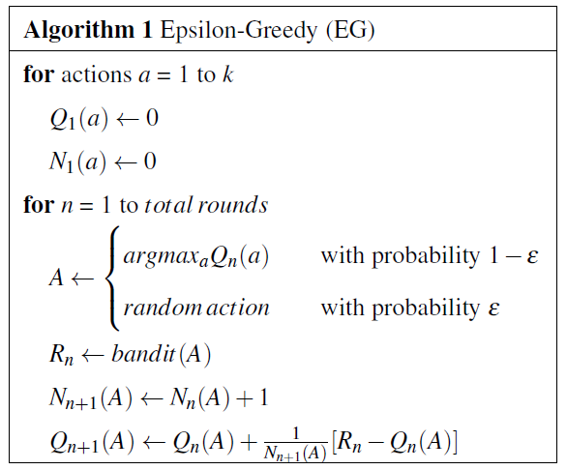
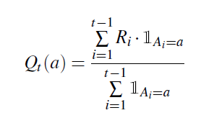
Solutions
Epsilon-Greedy Algorithm
Action-Value Estimate:

Slide 8
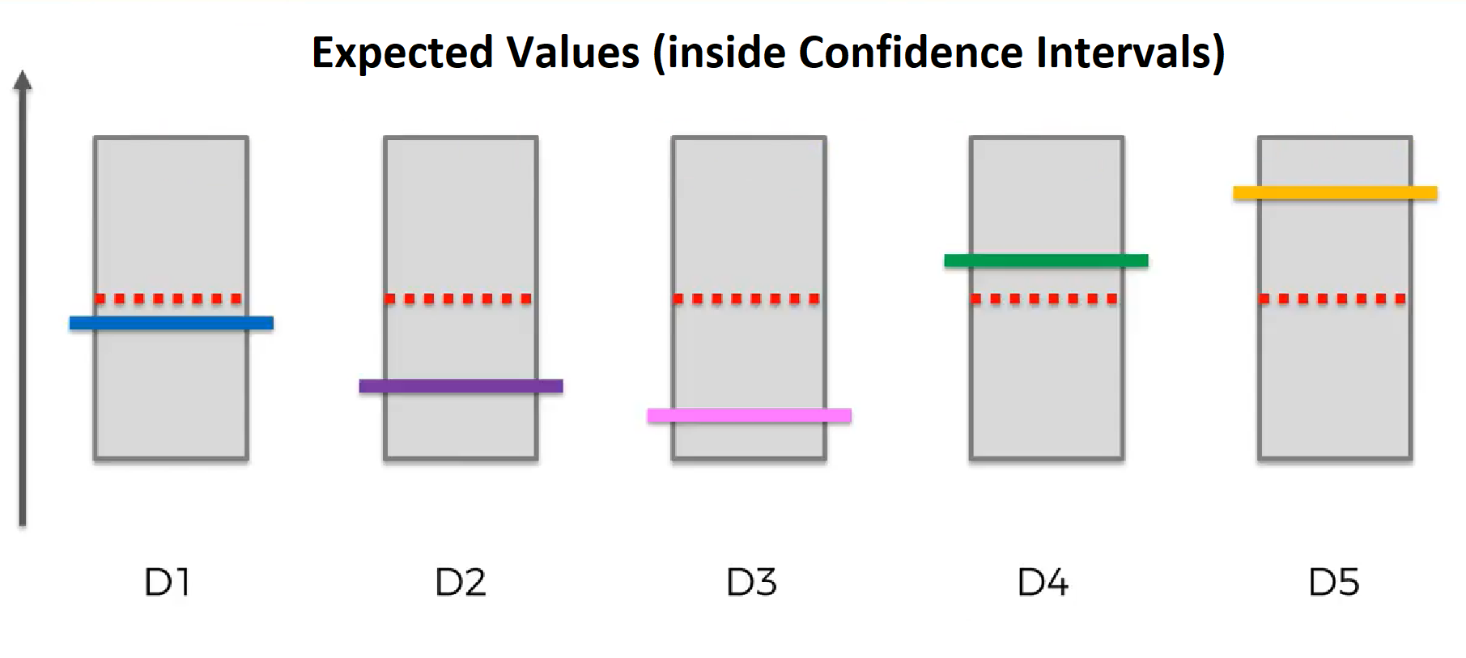
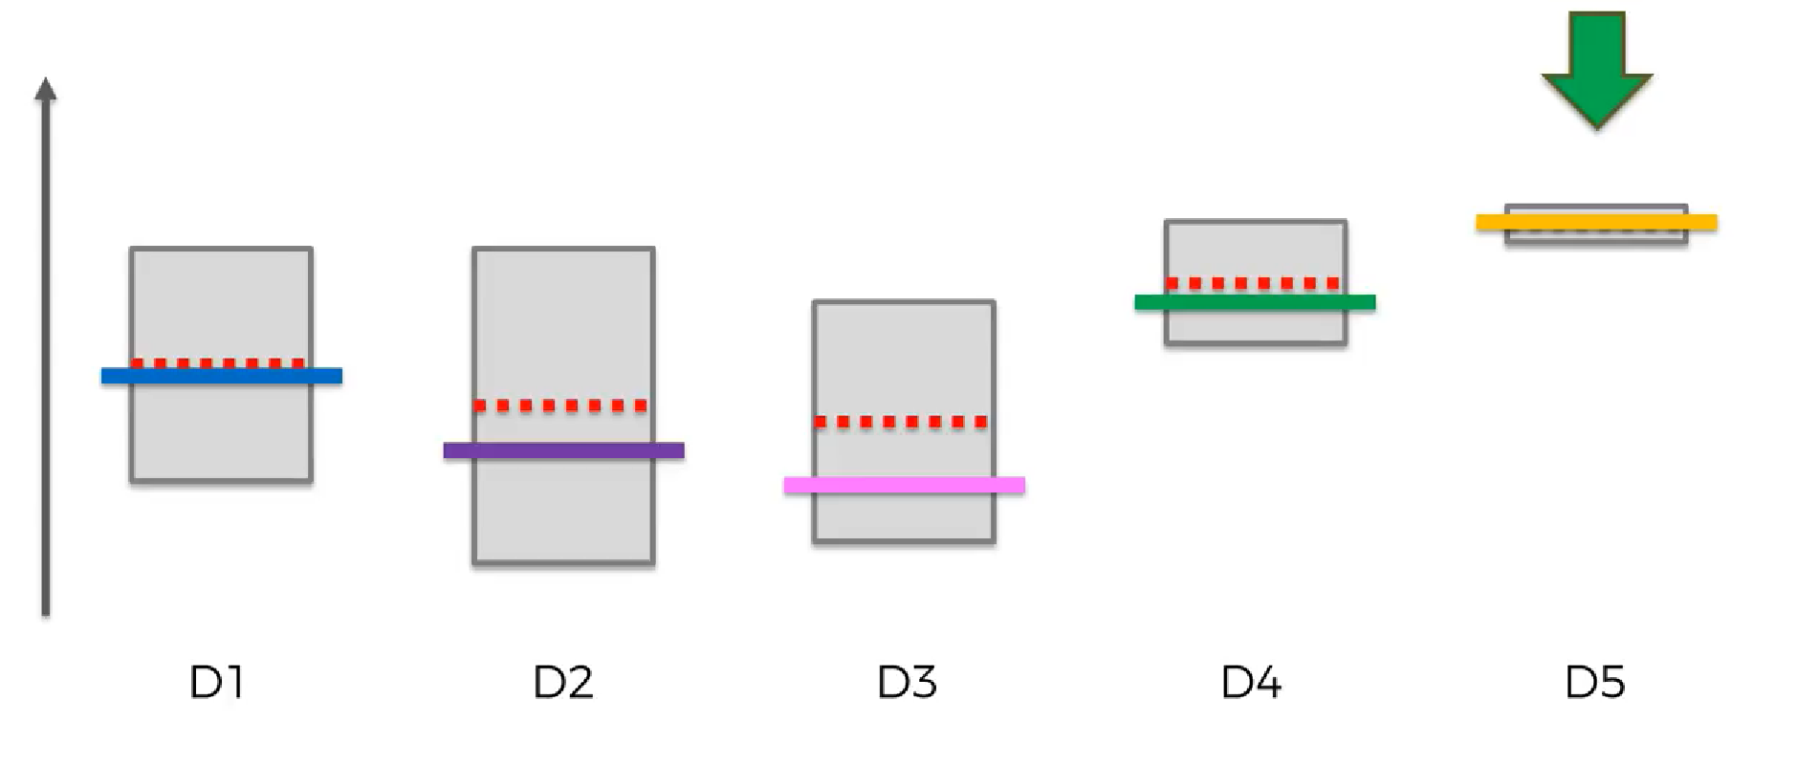
Solutions
Upper Confidence Bound (UCB) Algorithm
In this approach, expected values (mean of unknown distributions) will be considered.
For each website, confidence intervals will be initiated (ensuring that expected value is in range).
On each observation, confidence intervals decreases (uncertainty) and shifts up or down by a certain extent. The highest confidence interval is chosen for the next observation.
Algorithm continues until exploitation starts, i.e., (expected value ~= observed value and smallest interval).
Source: https://www.youtube.com/watch?v=UlgmUEKr7Lw

Slide 9
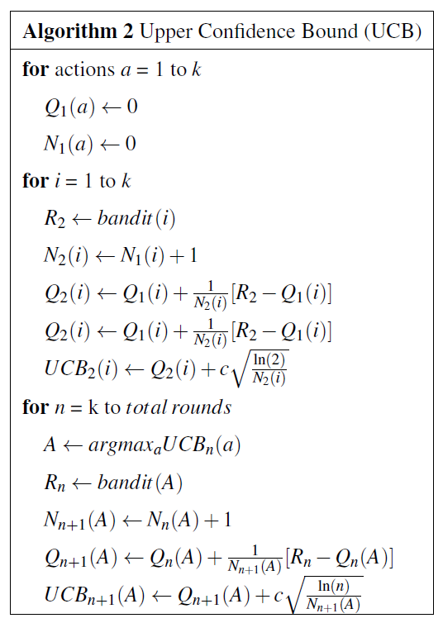
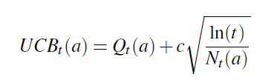
Solutions
Upper Confidence Bound (UCB) Algorithm
UCB Value = Action-Value Estimate + Uncertainty:

Slide 10
Solutions
Stochastic Gradient Ascent (SGA) Algorithm
This approach selects each website based on the probability of its preference.
Preference probability is same for all websites at the start and varies based upon their selection and the average reward accumulated over time.
For a chosen website, the preference increases and at the same time, decreases for the rest of the websites.
The magnitude of the preference change is based upon the average reward in addition to the reward achieved at each time step.
The algorithm thus makes informed decisions with respect to the reward accumulation and the predictability of the reward from each website.

Slide 11
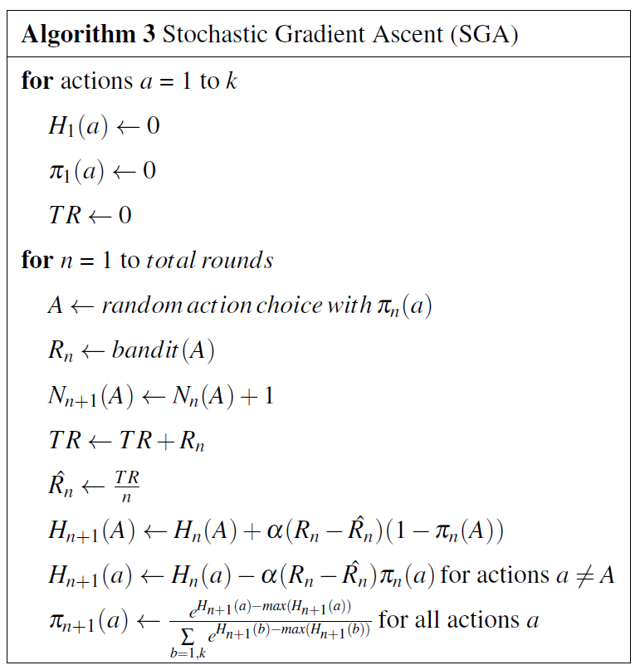
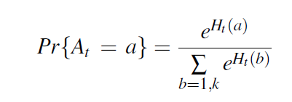

Solutions
Stochastic Gradient Ascent (SGA) Algorithm
Preference Probability:

Slide 12
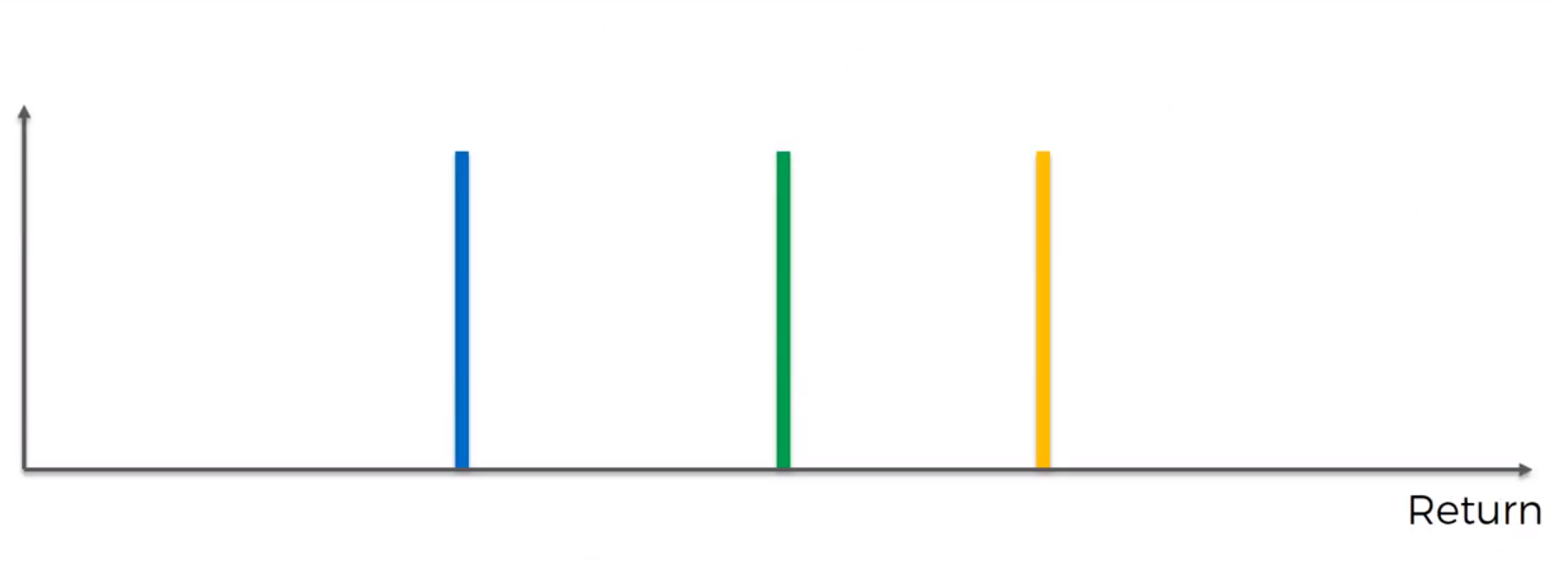
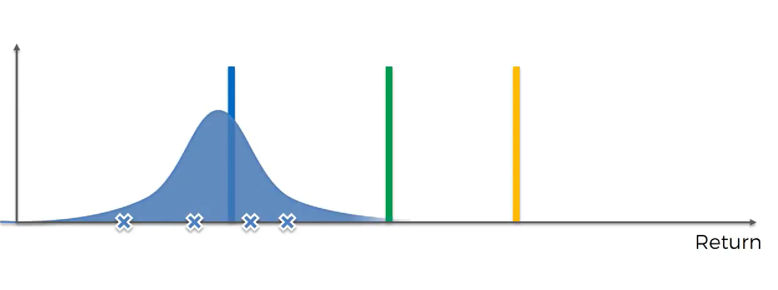
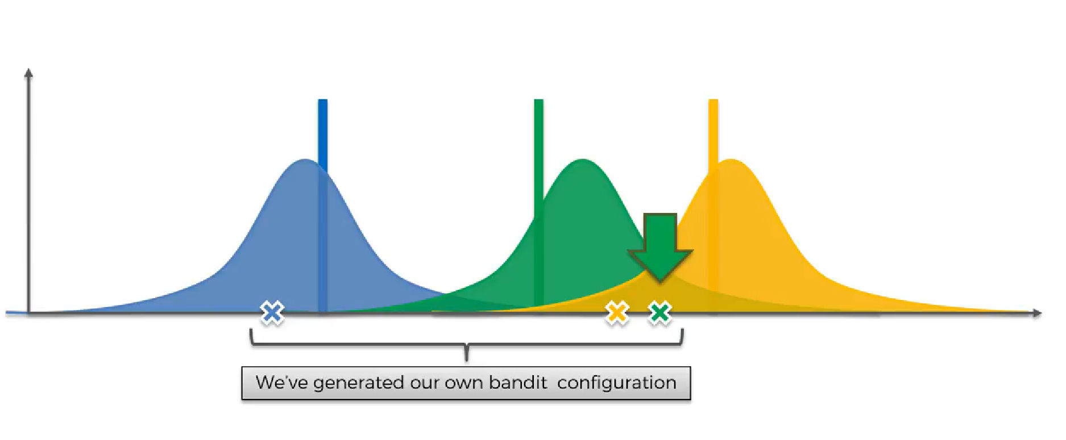
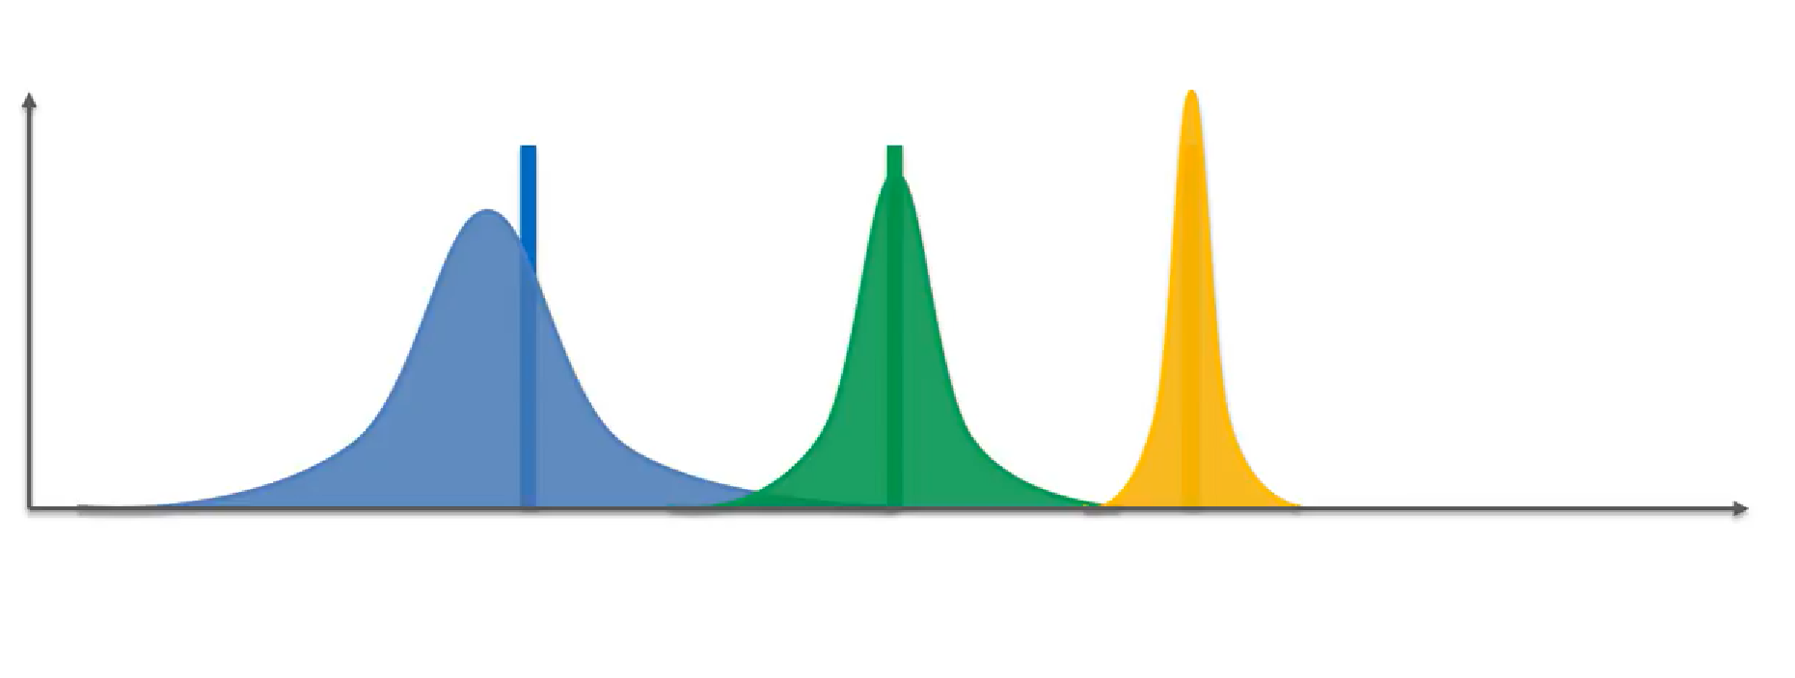
Solutions
Thompson Sampling
Use Bayesian inference to figure the website with the best outcome.
Start with uniform prior distribution.
For the first observation, take expected values from prior distribution.
Select highest expected value (imaginary) and calculate the posterior distribution.
Repeat this until expected value stops fluctuating, and select the website with the highest expected value.
Source: https://www.youtube.com/watch?v=A0UBgFXpmk4

Slide 13
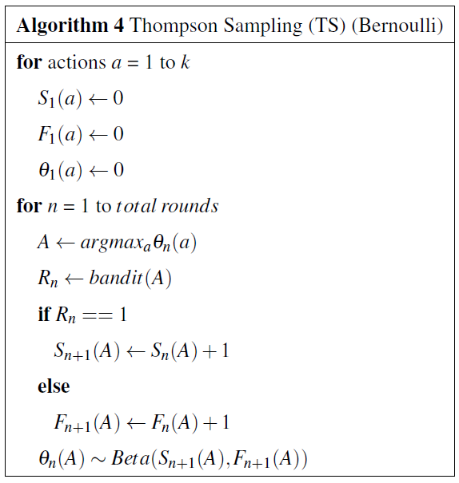


Solutions
Thompson Sampling
Posterior Probability:

Slide 14
Experimental Setup
100 experiments
10000 trials in each experiment
5 websites. Probabilities of receiving a click:
Website 1: 32%
Website 2: 24.5%
Website 3: 8.7%
Website 4: 64.5%
Website 5: 78.8%

Slide 15
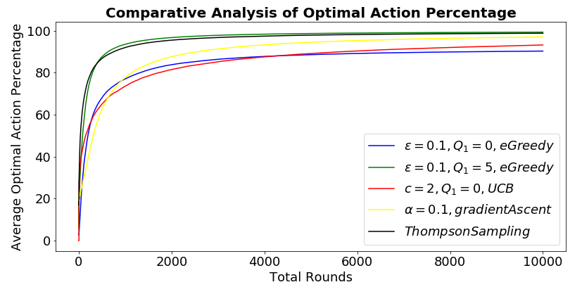
Results & Analysis – Optimal Action Percentage

Slide 16
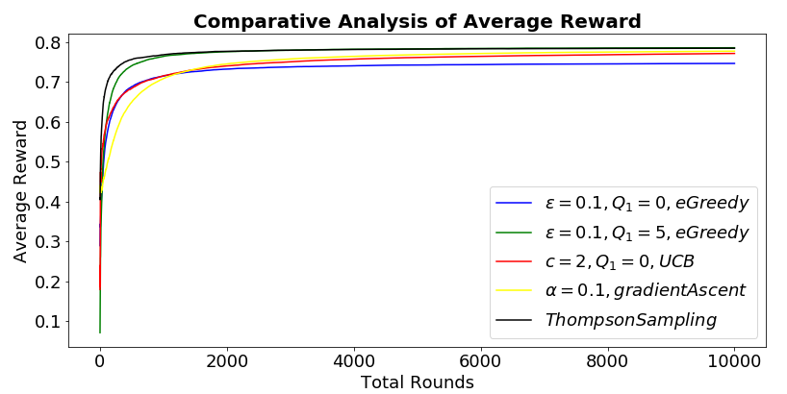
Results & Analysis – Average Reward

Slide 17
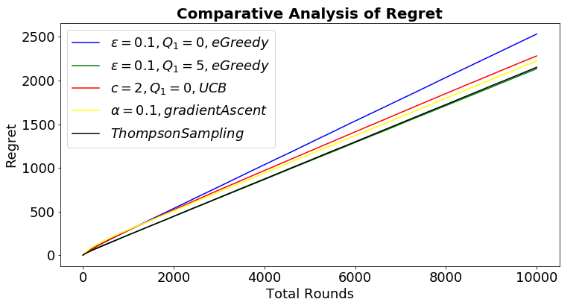
Results & Analysis – Regret

Slide 18
THANK YOU!

